Slide 1
Info/Homepage

Slide 2



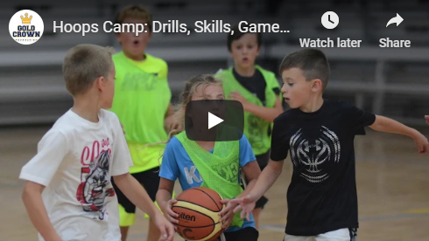
Youth Camp
Teen Camp
Young Adult Camp
Highlight on hover
INFO
LEAGUES
TOURNAMENTS
CAMPS
SIGN UP
GALLERY
Info, Leagues, etc, have drop down options
Denver Nuggets Hoops Camp Hosted by Chauncey Billups
Dates, Times, and Sessions
Week 1: July 9 – 13
Session 1 – 10am – 12pm: COED Grades 2nd – 4th
Session 2 – 1pm – 4pm: Boys Grades 4th – 6th
Session 3 – 5pm – 8pm: Boys Grades 7th – 9th
Week 2: July 16 – 20
Session 4 – 10am – 12pm: COED Grades 2nd – 4th
Session 5 – 1pm – 4pm: Girls Grades 4th – 6th
Session 6 – 1pm – 4pm: Girls Grades 7th – 9th
AM Sessions – $130 per camper *Coming both weeks? Contact our office for a discount!
Our Hoops Camp is the inaugural event hosted by Chauncy Billups, and has now grown into one of the most successful girls and boys basketball camps in the Denver Metro Area. Divided into multiple sessions, the daily schedule is fast paced with approximately one hour of fundamentals and drills, 30 minutes of contests for prizes and 90 minutes of games in a league format. Coaches place players on teams based on height and ability in order to help balance camp competition. In addition to daily games, there will also be an all camp tournament the final day of camp. All sessions will take place at the six-court Gold Crown Field House, Colorado’s Premier Youth Basketball Facility. Campers should come ready to work, as we keep them moving throughout the day. Each camper that attends will also win at least one prize throughout the week!

Slide 3
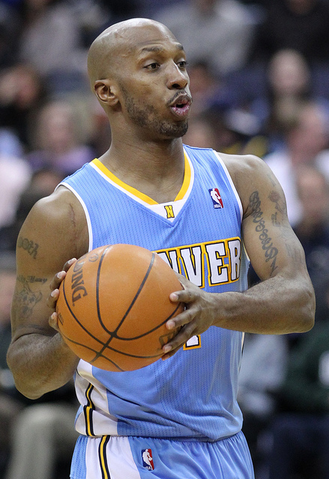
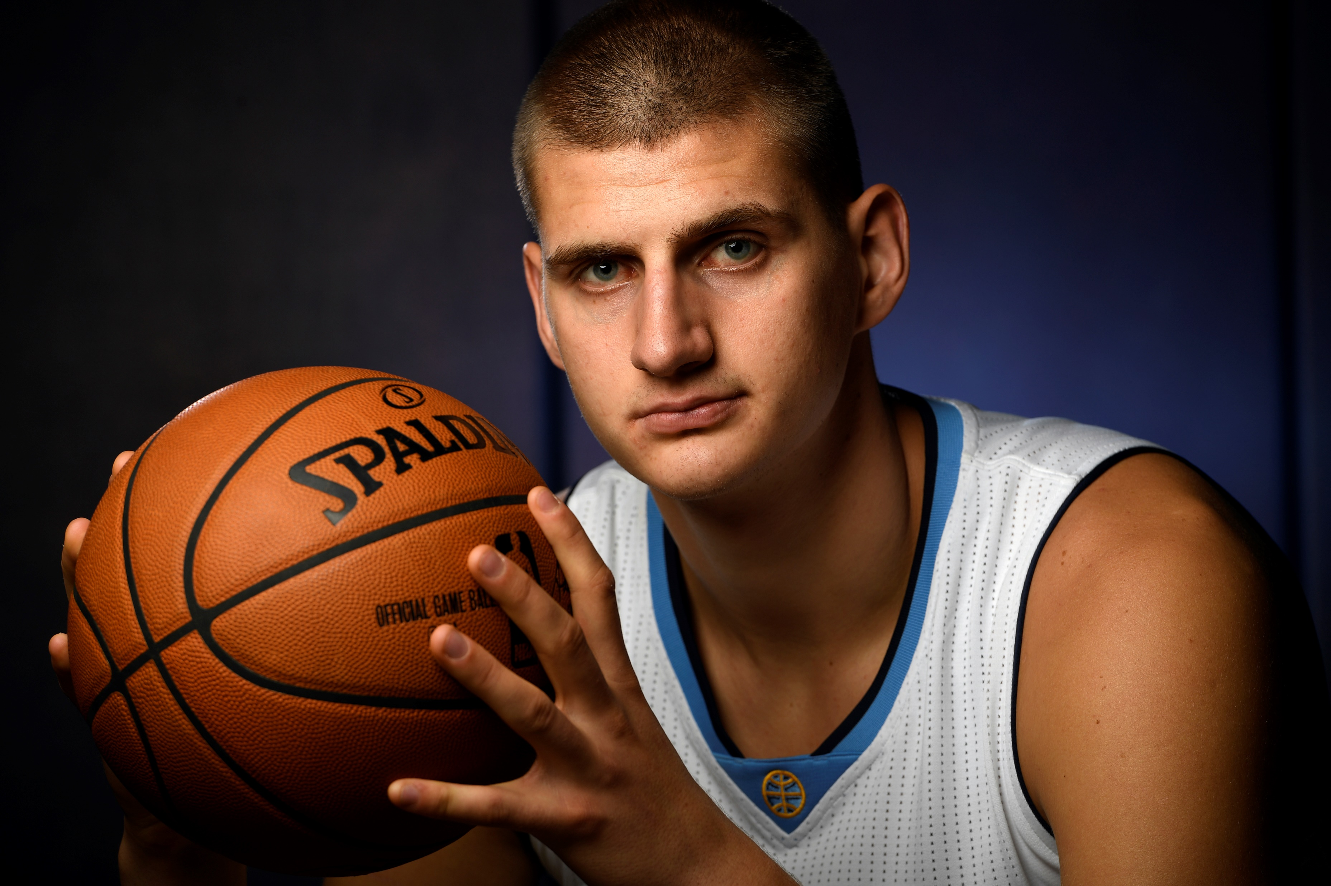
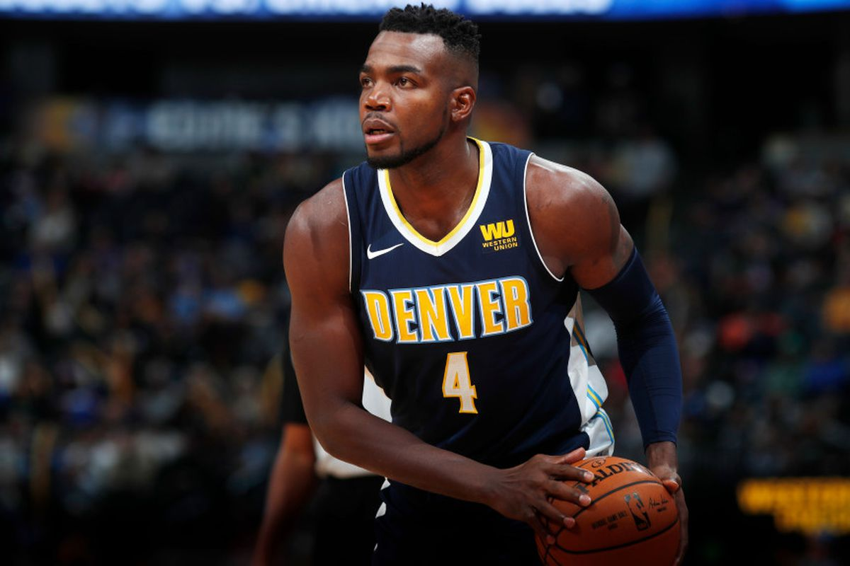
Chauncey Billups Bio
Afternoon/PM Sessions – $155 per camper *Have a kid coming each week, contact our office for a friends and family discount!*
Grab a friend and save with our Buddy Pass!Register 2 kids for $260 save! Note: A limited number of Buddy Pass Registrations are available, reserve your spot before we run out!
Regular Guest Coaches
Chauncey Ray Billups (born September 25, 1976) is an American retired professional basketball player who played 17 seasons in the National Basketball Association (NBA). A star at the University of Colorado, he was selected third overall in the 1997 NBA draft by the Boston Celtics. A five-time NBA All-Star and a three-time All-NBA selection, Billups played for the Celtics, Toronto Raptors, Denver Nuggets, Minnesota Timberwolves, Detroit Pistons, New York Knicks, and Los Angeles Clippers during his NBA career. He won the NBA Finals MVP in 2004 after helping the Pistons beat the Los Angeles Lakers in the Finals, and was given the nickname "Mr. Big Shot" for making late-game shots with Detroit. The Pistons retired his number #1 jersey in 2016.
Nikola Jokić
Paul Millsap

Slide 4







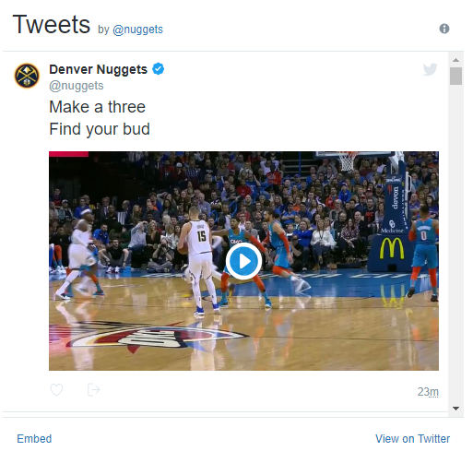
Carousel
Follow Us On Social Media
Check us out on Facebook, Twitter and Instagram (@nuggets) for athletic program news, event registration, community events, contests, giveaways and more! #Nuggets
Mission
"Educating youth and community through sports and enrichment programs."

Slide 5
Sign Up Page

Slide 6
Youth Camp
Teen Camp
Young Adult Camp
INFO
LEAGUES
TOURNAMENTS
CAMPS
SIGN UP
GALLERY
Sign Up
*Information will be added to a wait list
First Name
Last Name
Child’s First Name
Child’s Last Name
Child’s Birthday
Email
Phone Number
Submit

Slide 7
Gallery

Slide 8
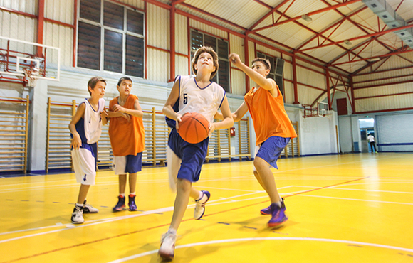
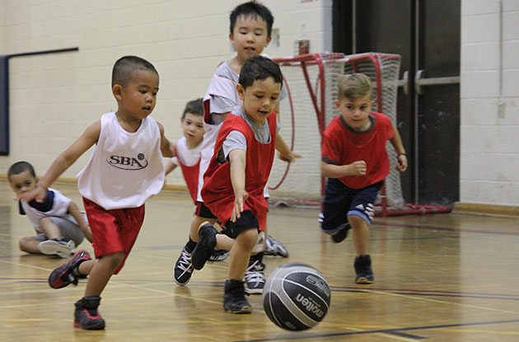
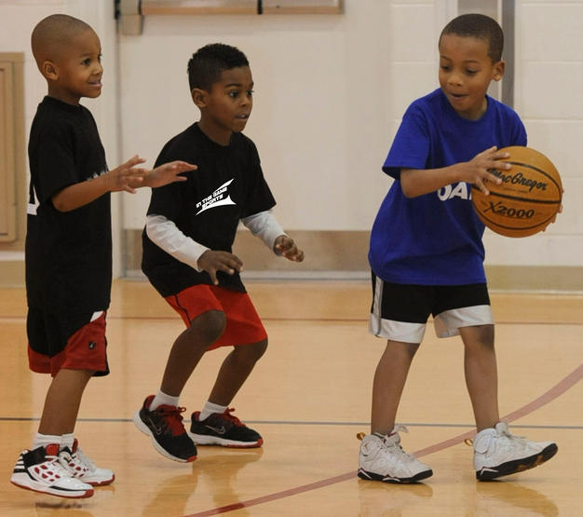
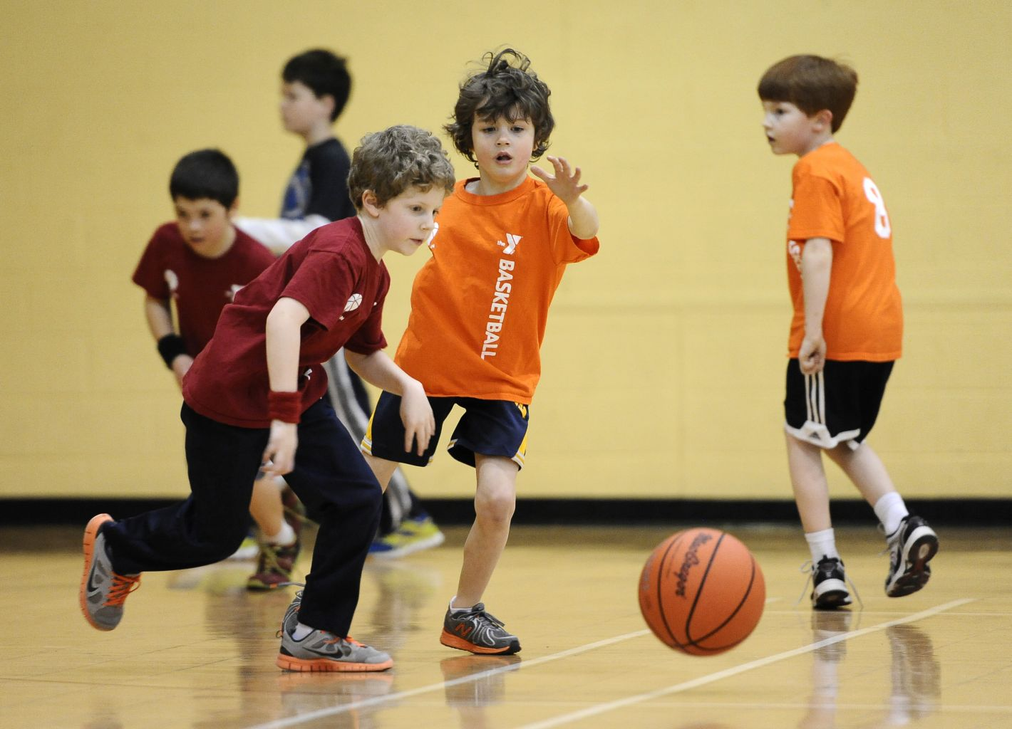
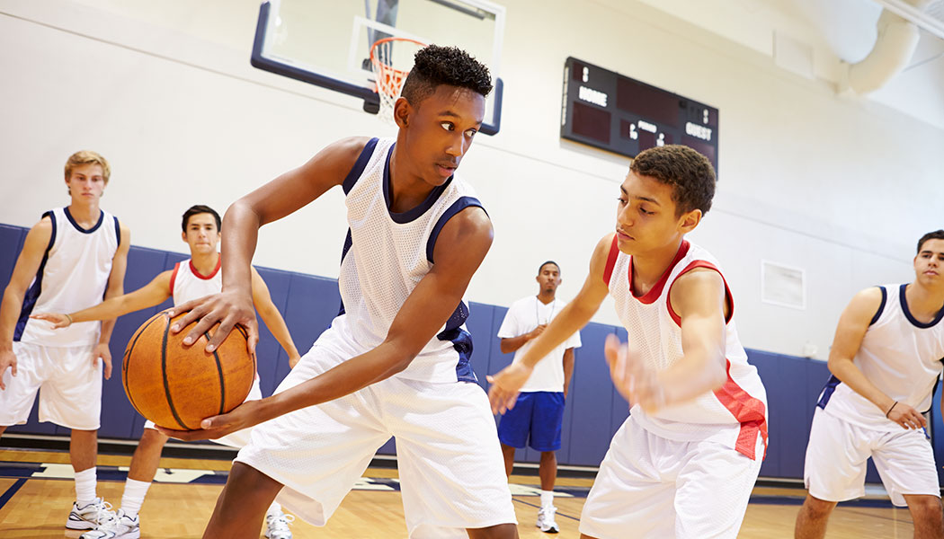
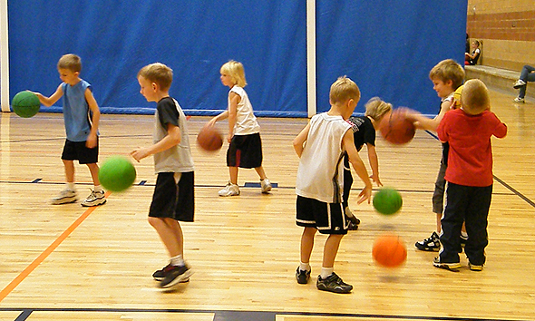
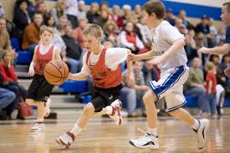
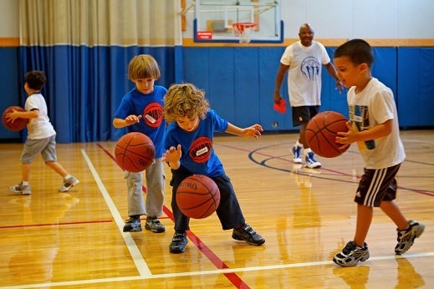
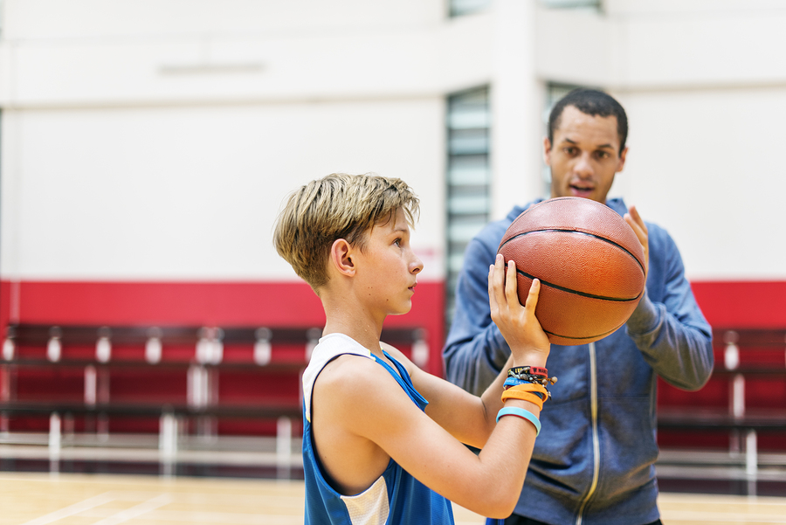
Youth Camp
Teen Camp
Young Adult Camp
INFO
LEAGUES
TOURNAMENTS
CAMPS
SIGN UP
GALLERY
Gallery

